Slide 1


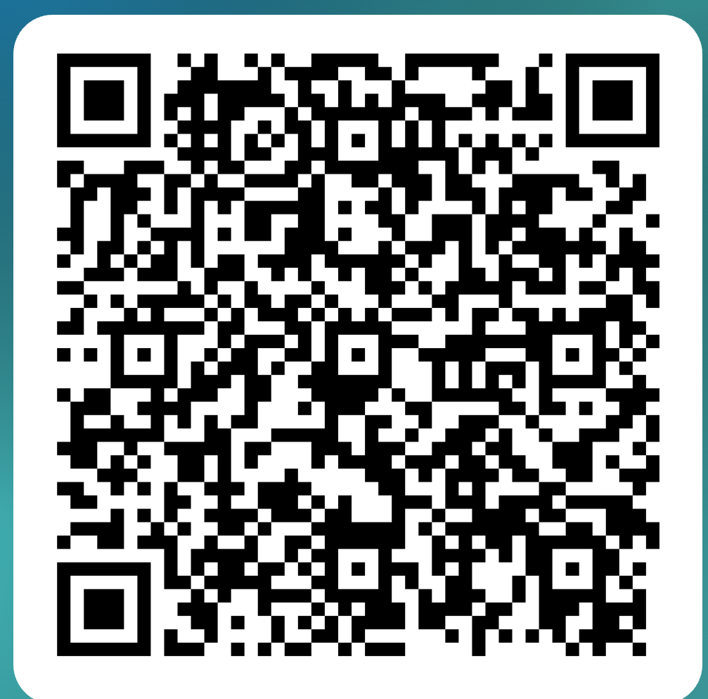
Community Screening
Georgia Highlands College
Cartersville campus room A160
Sept. 24th
1:00 pm
RSVP for Free Entry below:
Filmmaker John Jurko II Q&A session to follow
The Story
South African wildlife rangers risk all
to protect rhinos from poaching syndicates.

